Slide 1

Friday Fives
February 12, 2021
NOTE: Each Link Included in the Description

Slide 2
Five Web Resources for Your Review
Marketing-Related
NOTE: Each Link Included in the Last Slide

Slide 3
1. Business Ideas that May Boom in 2021
2. Does Your Website have a Press Page?
3. Is Content Marketing a Dead-End Job?
4. Learn How to Make Money with Your Blog
5. How to Create Videos for Your Business

Slide 4
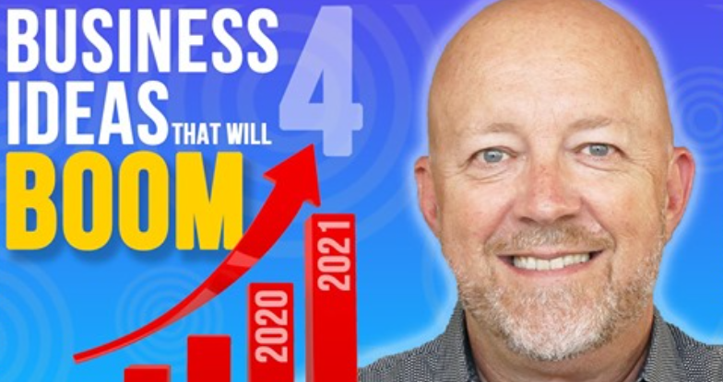
1. Business Ideas that May Boom in 2021
https://www.youtube.com/watch?v=1_UOys-q7q0

Slide 5
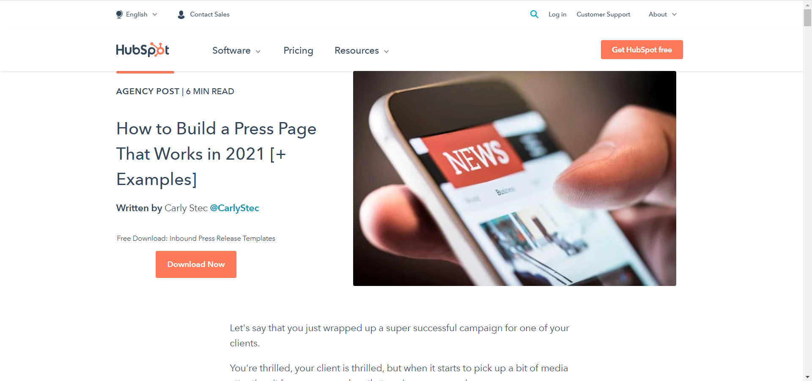
1. Business Ideas that May Boom in 2021
2. Does Your Website have a Press Page?
https://blog.hubspot.com/agency/perfect-press-page

Slide 6
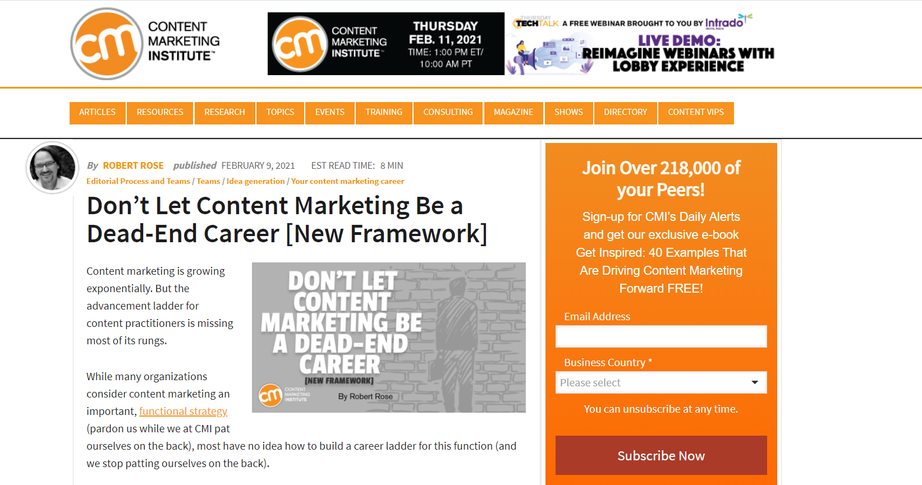
3. Is Content Marketing a Dead-End Job?
https://contentmarketinginstitute.com/2021/02/content-marketing-career-framework/

Slide 7
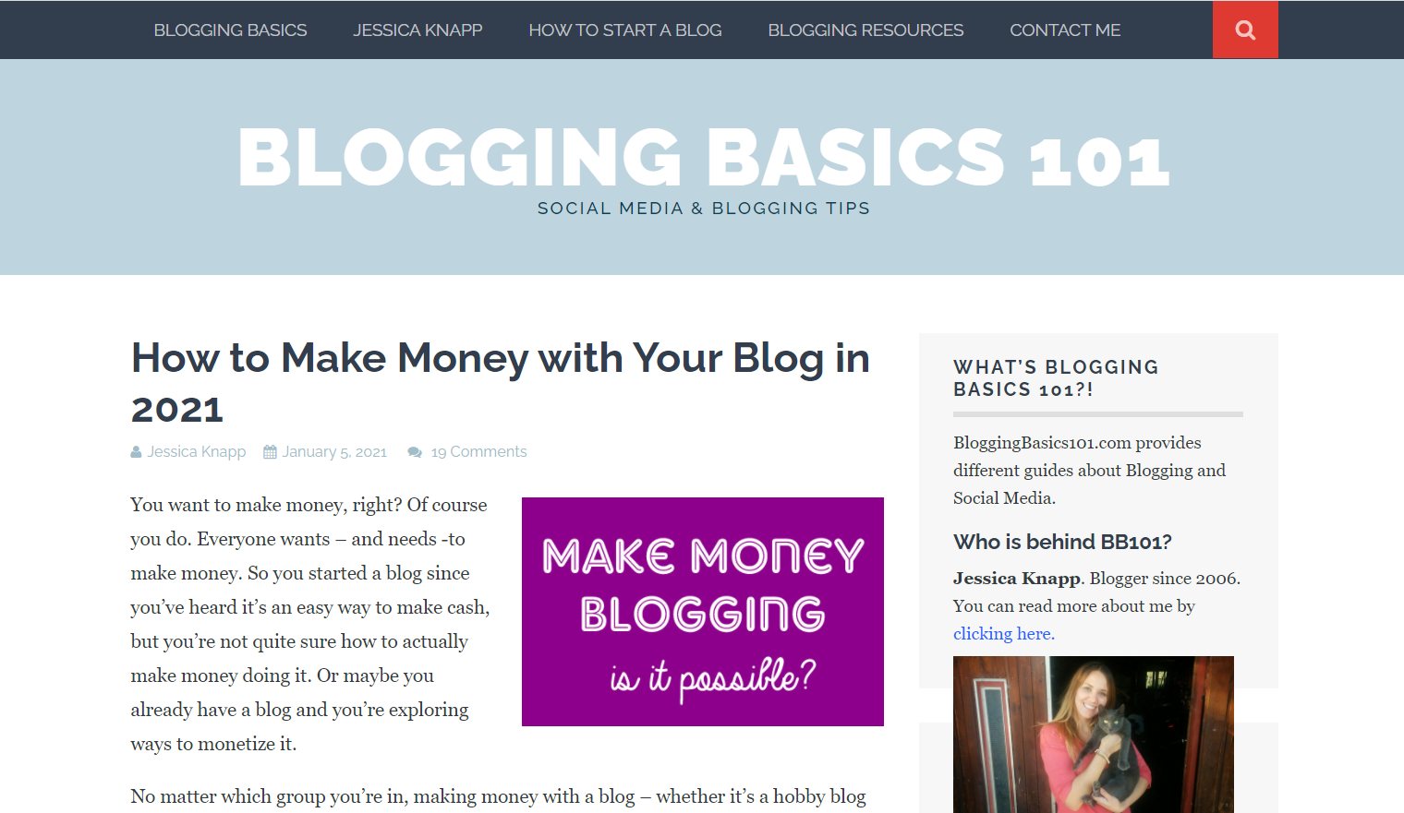
4. Learn How to Make Money with Your Blog
https://www.bloggingbasics101.com/how-can-i-make-money-from-my-blog/

Slide 8
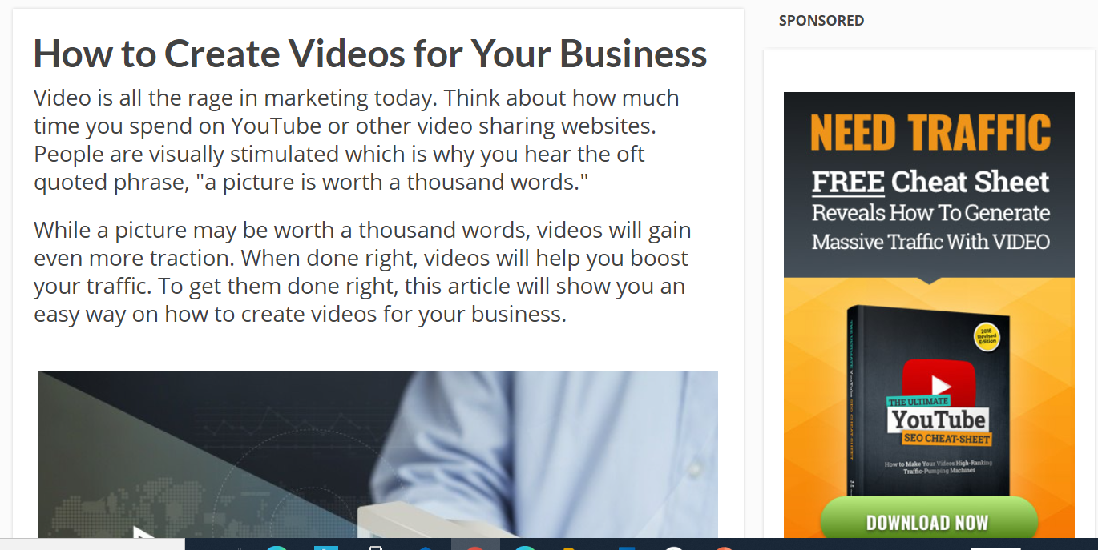
5. How to Create Videos for Your Business
https://getpaidbootcamp.com/how-to-create-videos-for-your-business/

Slide 9
LINKS DISCUSSED IN VIDEO:
https://www.youtube.com/watch?v=1_UOys-q7q0
https://blog.hubspot.com/agency/perfect-press-page
https://contentmarketinginstitute.com/2021/02/content-marketing-career-framework/
https://www.bloggingbasics101.com/how-can-i-make-money-from-my-blog/
https://getpaidbootcamp.com/how-to-create-videos-for-your-business/

